Slide 1
AXIS Audio Manager 3.3.1.3.25 release.
Differences between previous release (3.2.0.2.29) and 3.3.1.3.25

Slide 2
3.3.1.3.25 Release notes
* Items with an asterisk are explained further in a later slide
New features in 3.3.1.3.25
The name of the application changed from AXIS Audio Manager to AXIS Audio Manager Pro
The license model of AXIS Audio Manager Pro is changed to a perpetual and unlimited.
Separate device licenses are no longer required for customers of the C7050 server expanding beyond 300 devices. The license in C7050 installations are automatically upgraded to the new license.
Adding AXIS Network Audio devices manually with help of AXIS Device Manager. This devices can be located outside the original broadcast domain the AXIS Audio Manger resides in. (*)
Added volume settings for 2N SIP Mic when configuring via AXIS Audio Manager Pro
Enabled AXIS C8210 Network Audio Amplifier as an audio source in AXIS Audio Manager Pro
The default Admin password is required to be changed after first log in

Slide 3
3.3.1.3.25 Release notes (cont.)
Changes made in 3.3.1.3.25
Updated MS Visual C++ package
Removed older unsupported device settings
IPv6 interface settings are not displayed anymore
Control Panel Window layout improvements
Performance improvements
Limitations in 3.3.1.3.25
By unchecking “Audio source” flag in device properties, AXIS C8033 and C8210 will be removed from Audio sources but not from the device database. To remove the C8033/C8210 completely as a source it must be removed from the database as well.

Slide 4
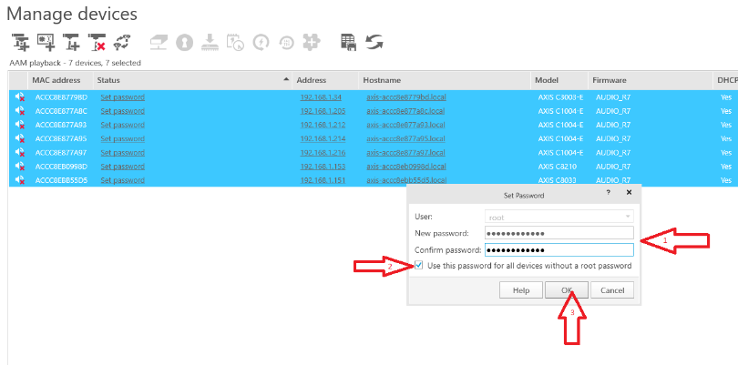
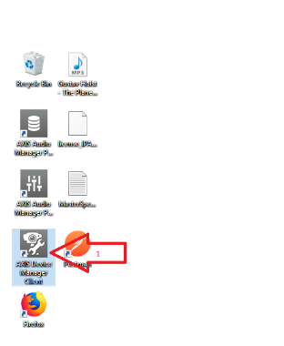
Adding AXIS Network Audio devices manually with help of AXIS Device Manager
Now you can add Network Audio devices manually
Make sure AXIS Device Manager (ADM) is accessible and can reach the devices you like to configure.

Slide 5
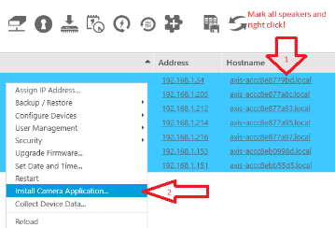
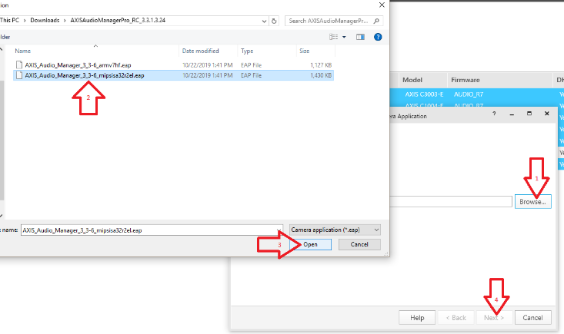
Adding AXIS Network Audio devices manually with help of AXIS Device Manager
Deploy AXIS Audio Manger ACAP on the devices

Slide 6
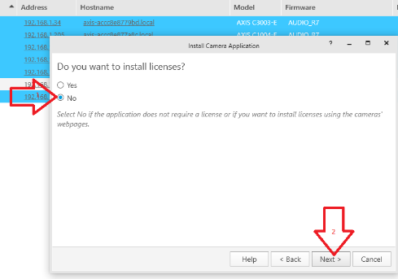
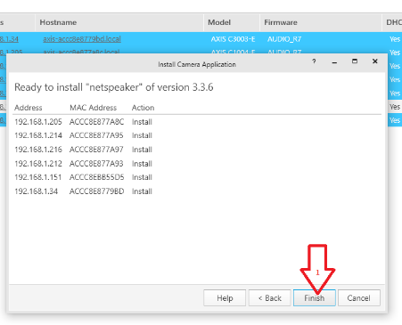
Adding AXIS Network Audio devices manually with help of AXIS Device Manager
Continue to deploy AXIS Audio Manger ACAP on the devices

Slide 7
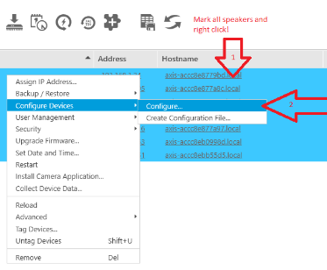
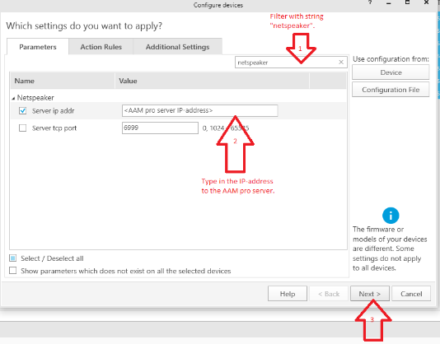
Adding AXIS Network Audio devices manually with help of AXIS Device Manager
Configure the AXIS Audio Manger ACAP via ADM

Slide 8
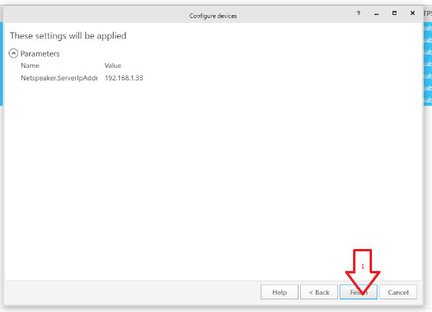
Adding AXIS Network Audio devices manually with help of AXIS Device Manager
Finish the AXIS Audio Manger ACAP configuration via ADM

Slide 9
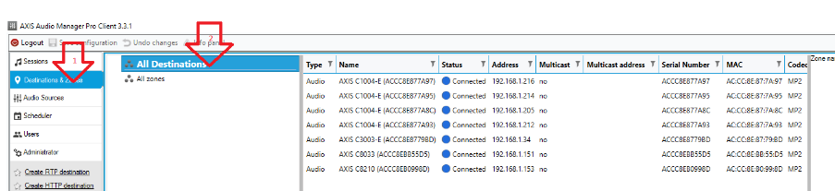
Adding AXIS Network Audio devices manually with help of AXIS Device Manager
In AXIS Audio Manager check if all devices are showing up as connected

Slide 10


