Slide 1
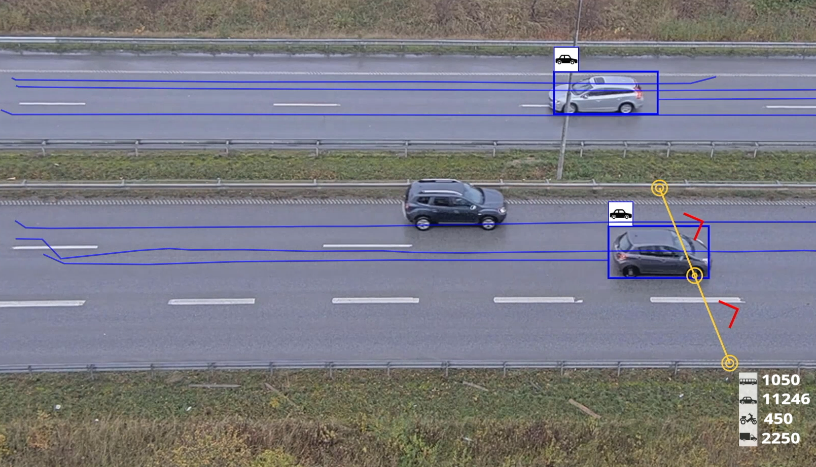

Crossline counting and
Innovating for a
smarter, safer world
line crossing automated actions
AXIS Optimizer for XProtect
Notes:
Crossline counting and line crossing automated actions

Slide 2
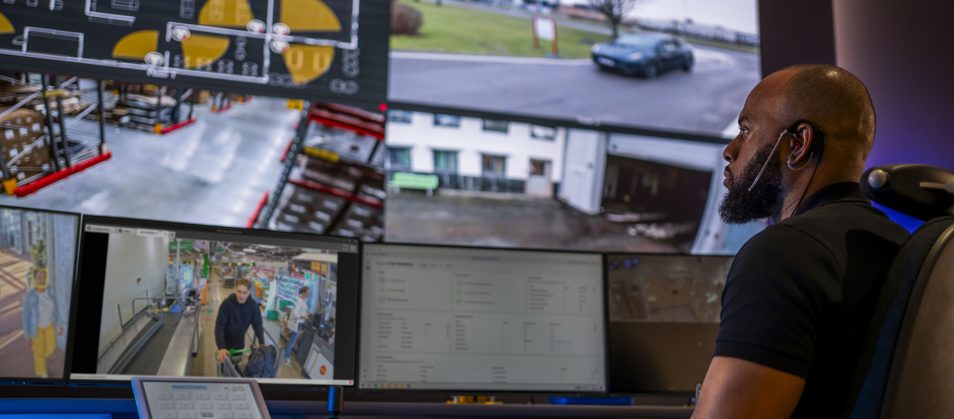
Are you acting on line crossing?
Core Problem: systems are set up to notify rather than act
Even with crossline detection enabled many systems fail to act in real-time because:
  Lack united workflow
  Operator overload
  All alerts treated equally
  Human factors
  Integration gaps
Notes:
Core Problem: most failures happen because systems are set up to notify rather than act. Real-time response requires automation that instantly executes predefined actions for routine events, while escalating only exceptional situations to human operators.
Even with crossline detection enabled many VMS systems and operators often fail to act in real-time because:
Lack united workflow: requires seamless integration of various stages — detection, rule-based event-to-actions, event management and automation
Operator overload: too many alerts, too few operators. A single operator monitoring multiple cameras simply can't respond to everything simultaneously. When multiple crossline events happen at once, some get missed or delayed. And worse, alert fatigue sets in: if the system generates frequent false alarms, operators start ignoring notifications altogether.
All alerts treated equally: an unauthorized person crossing into a restricted zone gets the same visual/audio alert in VMS as a authorized person. Without prioritization, critical events get buried among routine ones. Operators or investigators waste time on low-priority crossings while missing urgent ones. Again: alert fatigue sets in.
Human factors. Manual process take time and prone to errors: delays are inevitable when every crossline detection requires an operator to manually review, decide, and act. During shift changes, breaks, or high-activity periods, response times stretch from seconds to minutes—or events get missed entirely. Predefined automated responses for specific priority actions (e.g unknown person detected in restricted area) means every incident is managed. Understaffed control rooms can be commonplace during certain shifts. Operators that are not properly trained on what different crossline events mean or how to respond and manage the incident properly. High turnover means constantly retraining staff on procedures
No united view: event notifications can lack context—an alert pops up but doesn't show which camera/line was crossed. Operators must click through multiple screens to understand what's happening, losing precious seconds.
Integration gaps: crossline detection doesn't trigger proper actions in other systems (audio, access control, alarms, lighting). So every action requires manual intervention.

Slide 3

When acting on crossline detection and counting incidents matter
Use Intelligent Automation (IA). Set up AI-powered intelligent automation to do something automatically in real-time in response to line crossing events
Instantly execute: predefined actions for specific, prioritized events — always
United workflow: set up metadata thresholds in camera edge analytics scenarios, set rules engine and get overview of all events directly in XProtect Management Client
Faster and proper responses: security incidents unfold in seconds or minutes. Efficient event management ensures the right actions are connected to specific real-time events.
Notes:
Why crossline counting and automated actions matters
Crossline counting or line crossing alone just tells you "someone/so many people crossed a line." That's useful data, but it just sits there.
Adding ai-powered automated actions makes the system do something with that information automatically in real-time.
Our solutions means:
Intelligent Automation (IA). Set up AI-powered intelligent automation to do something automatically in real-time in response to line crossing events
Instantly execute: predefined actions for specific, prioritized events — always
United workflow: set up metadata thresholds in camera edge analytics scenarios, set rules engine and get overview of all events directly in XProtect Management Client
Faster and proper responses: security incidents unfold in seconds or minutes. Efficient event management ensures the right actions are connected to specific real-time events.
Real-World Examples:
Security: an unauthorized person crossing into a restricted zone — typically gets the same visual/audio alert in VMS as an authorized person — triggers instant deterrence using audio/visual alerts and guards get an instant alert .
Safety: a store counts 200 people entering → system automatically locks the door and displays ”Full capacity" to prevent overcrowding in signage
Customer service: long customer checkout queue lines or many customers enter the store in an hour → audio message broadcasted that another checkout lane is opening and staff get an instant alert
Save money: last person leaves the office floor → lights and air conditioning automatically turn off/down after 30 minutes
Maintenance: 150 people use the restroom → cleaning staff gets a notification it needs attention
The Bottom Line:
Without automation, someone has to watch the counts and events notifications manually before responding. With full automation, admin roles set the system to handles prioritized, routine decisions instantly.

Slide 4

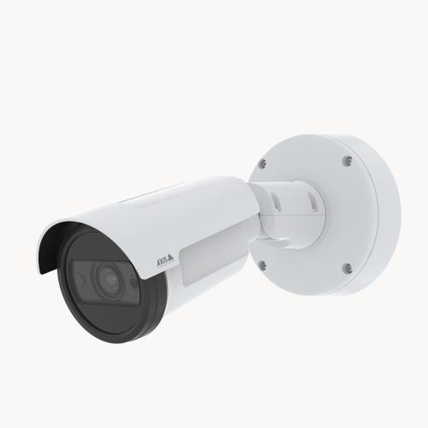
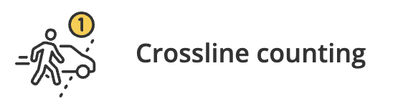
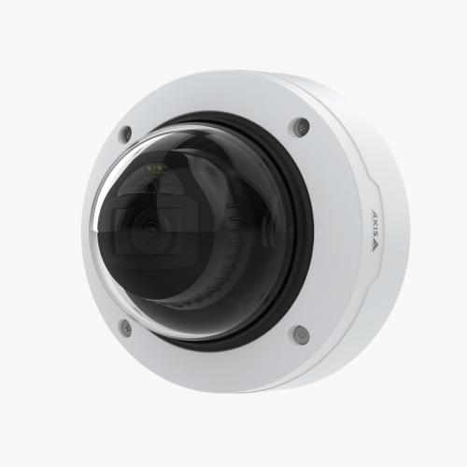

Crossline counting and
line crossing automated actions
AI-powered
automation
Set up scenario in AXIS Object Analytics
AI-powered analytic triggers event
XProtect Rules Engine +
AXIS Optimizer events control panel
Operator triggered action
AI-powered automation
Outcome: accurately manage real-time events

Slide 5
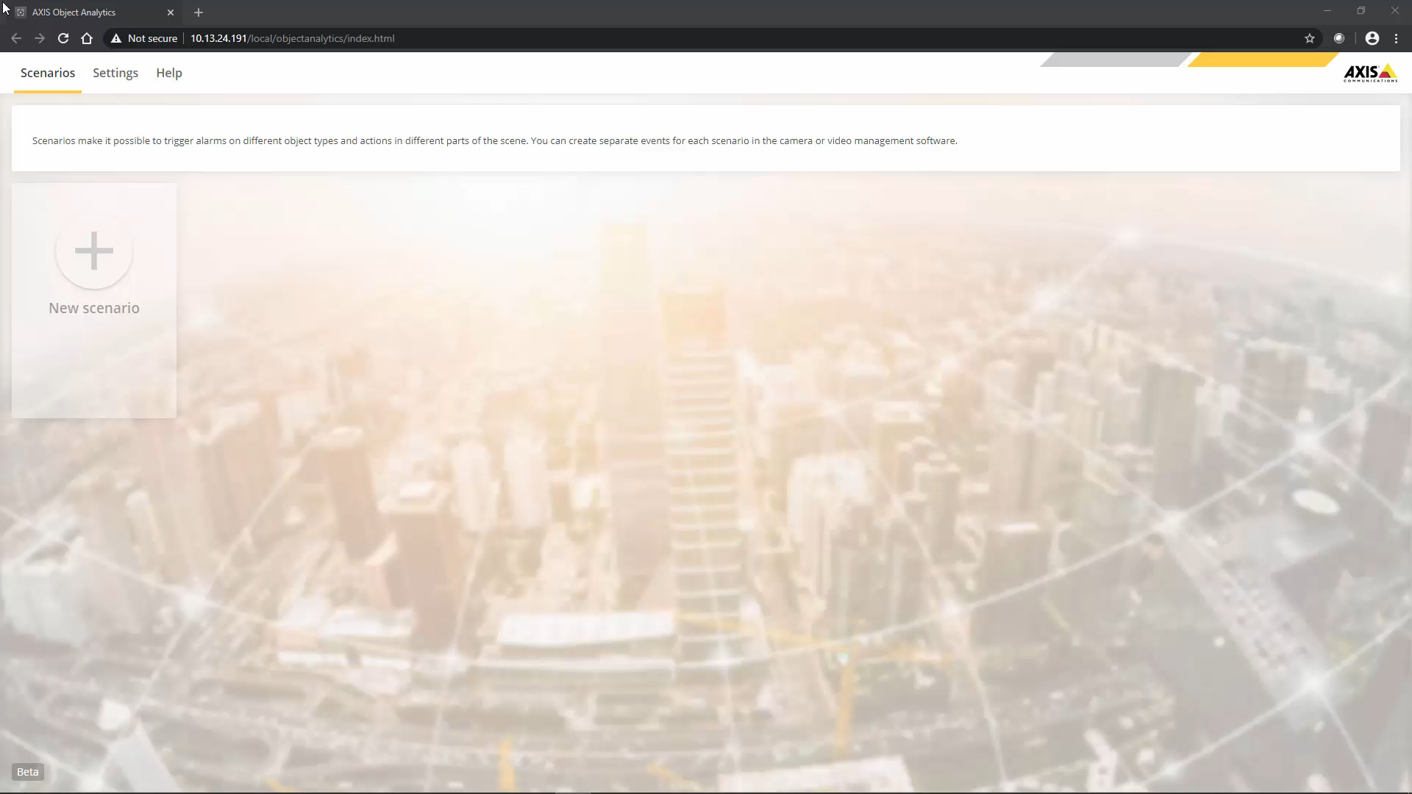
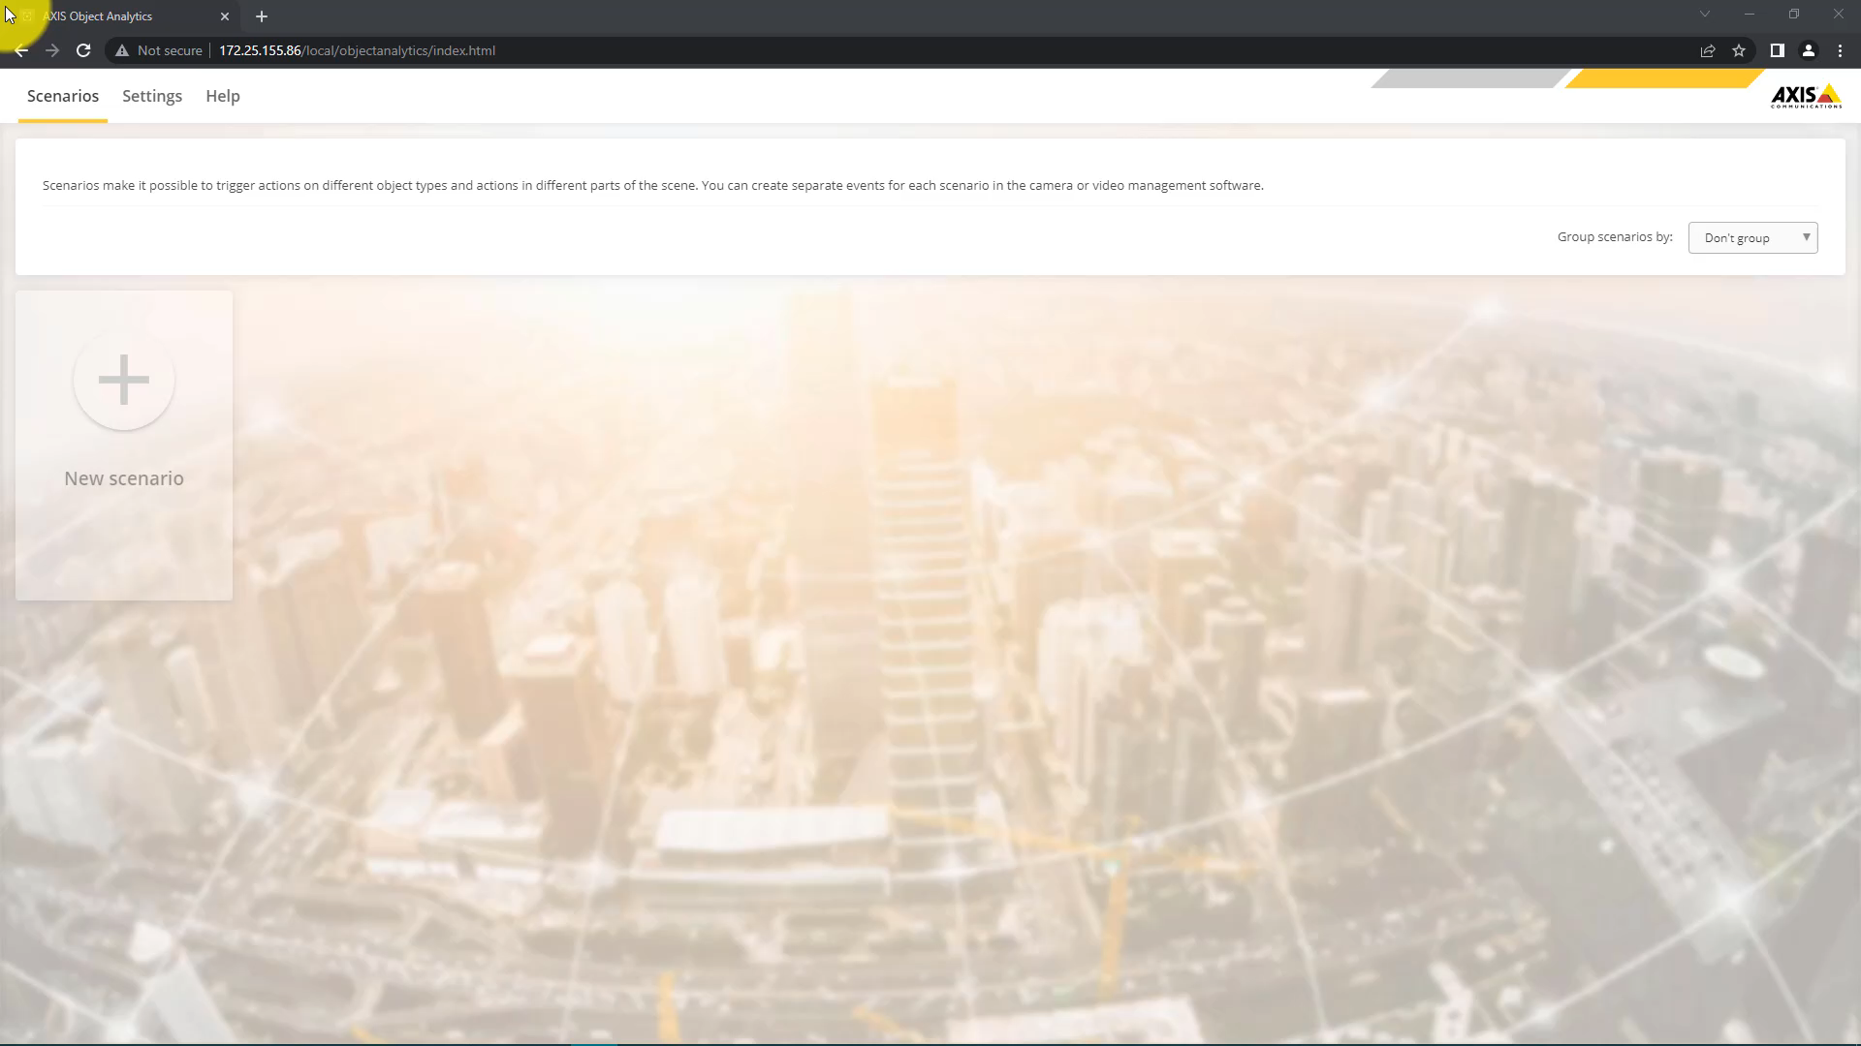
How it works – easily set up scenarios
Open AXIS Object Analytics in web browser
Line crossing
Easily set up the desired scenario
Adjust specifications and apply
Crossline counting
Notes:
AXIS Object Analytics offers a simple and user-friendly solution to set up your scenarios so that you can address the use case you would like to solve. Simply use an Axis network camera and
Open the analytics in a web browser
Click to create a new scenario
Adjust the scene to your specifications to include objects of interest, scenario and a threshold to trigger events if needed.
And then you simply apply the scenario.
Important: Click on “Playback” and check the box “Play full screen”. Alternatively, click on the “Animations” and then “Preview”.

Slide 6

AXIS Object Analytics – AI included in your camera
Detect, classify, track, and count humans and vehicles
For security, safety, and operational efficiency
Run multiple scenarios simultaneously on the edge
Flexible and easy configuration
Preinstalled at no extra cost
Notes:
Your camera can be more than just a camera (CLICK).
Using intelligent AI-based algorithms, AXIS Object Analytics adds AI to your camera. It can detect, classify, track, and count humans, vehicles, and types of vehicles*. Thanks to AI-based classification, you can focus only on objects of interest and events that need attention, making your monitoring more proactive and effective. (CLICK)
It’s possible to solve multiple use cases for security, safety and operational efficiency simultaneously (CLICK), and set up triggers for various events based on your needs. This allows you to respond appropriately to events in real-time, while helping optimize your business with automated processes and valuable insights into trends. (CLICK)
This powerful application is pre-trained with a straightforward user interface without any complex configuration needed. This enables you to set up scenarios tailored to your specific monitoring needs with just a few clicks directly inside the web browser. (CLICK)
This edge-based analytics comes pre-installed ad no extra cost on compatible cameras, and processes and analyses live video directly on the camera, which eliminates the need for costly servers. You also benefit from more efficient data processing, minimized storage and bandwidth requirements, and improved scalability. There is also no need for a system redesign or expensive hardware replacements when adding a new camera to your surveillance system.
Sounds interesting? Let’s have a look at an example of how AXIS Object Analytics can be used in a business (CLICK – to video)
Currently compatible cameras: www.axis.com/products/axis-object-analytics
Products are continuously being added.
*vehicle type classification requires a DLPU camera

Slide 7
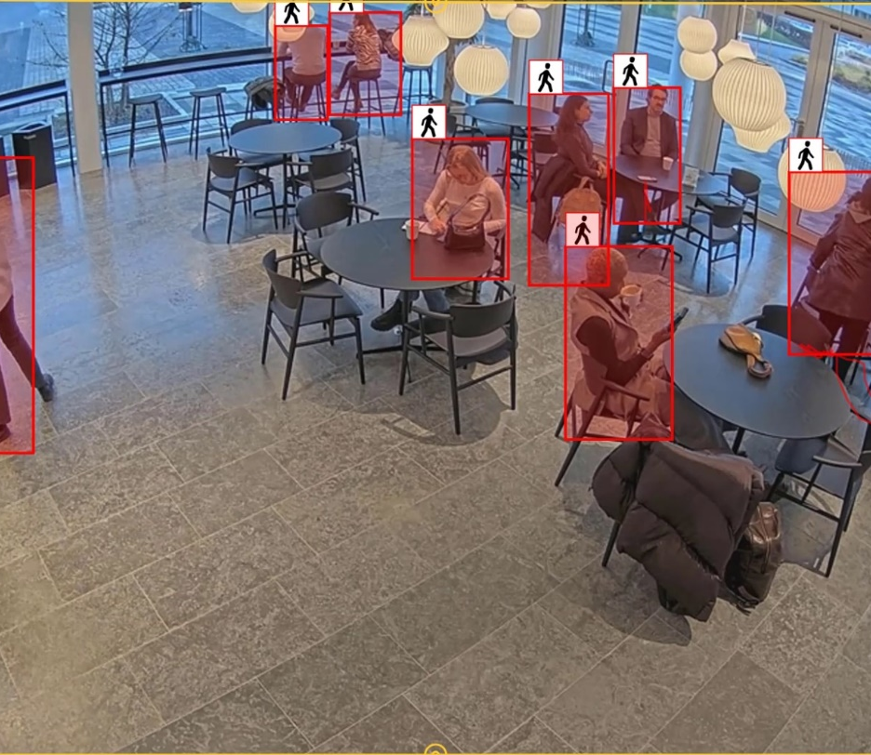
Highlights – AXIS Object Analytics
Suite of AI powered analytics
Solves multiple use cases centered around humans and vehicles
For security, safety, business intelligence and operational efficiency
Notes:
AXIS Object Analytics is a highly versatile analytics application. It is a suite of AI powered analytics and comes preinstalled on compatible Axis cameras – at no extra cost.
It helps solve numerous use cases centered around humans and vehicles, and can be used for security, safety, and operational efficiency by delivering intelligence based on the detection, classification, tracking, and counting of humans and vehicles for real-time responses, or actionable insights through aggerated data.

Slide 8
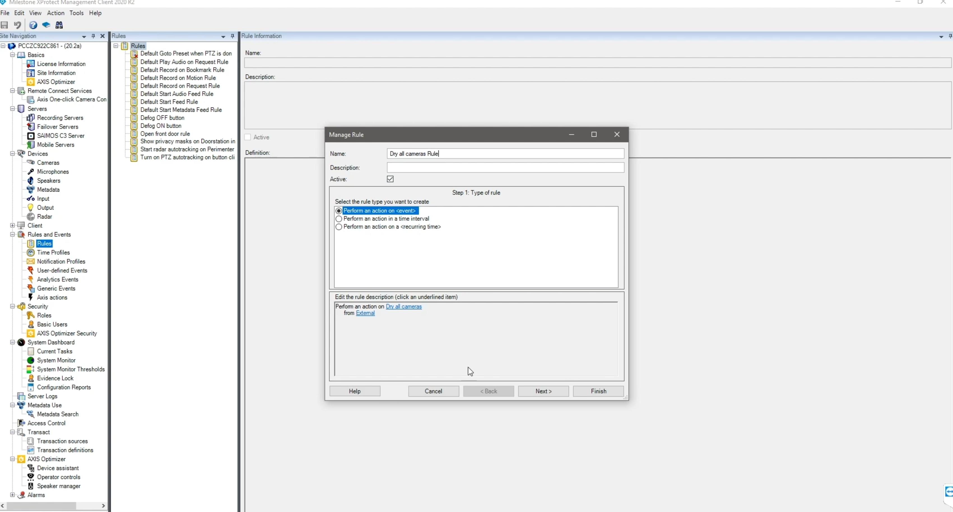
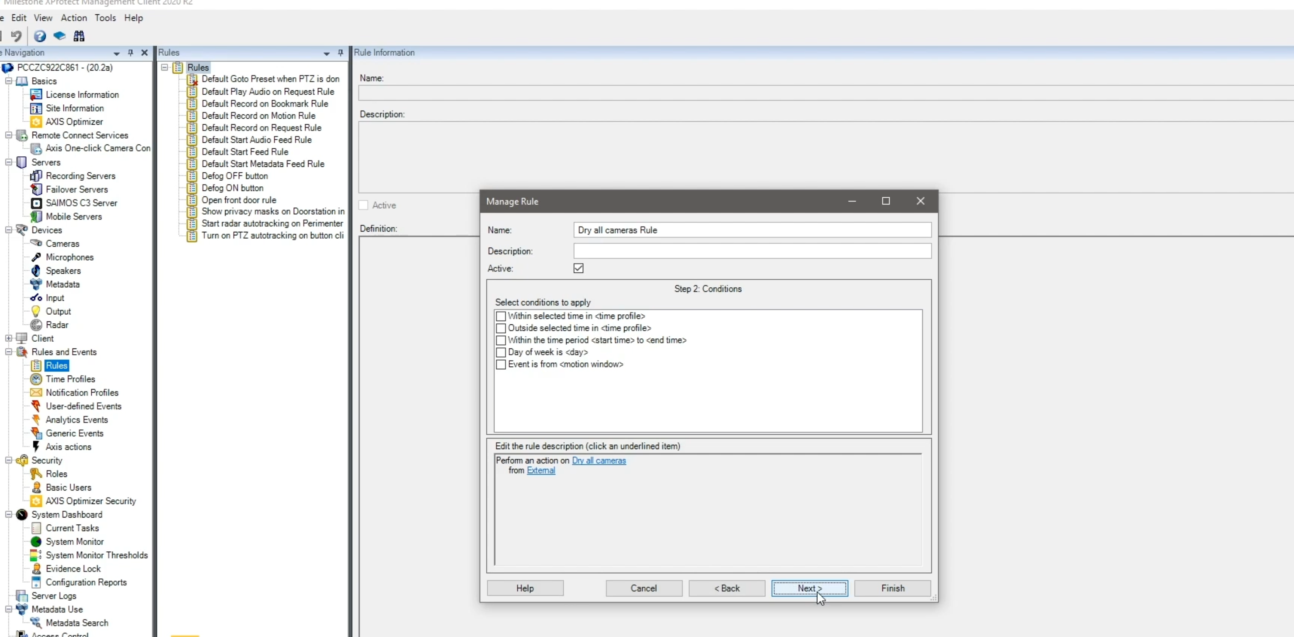
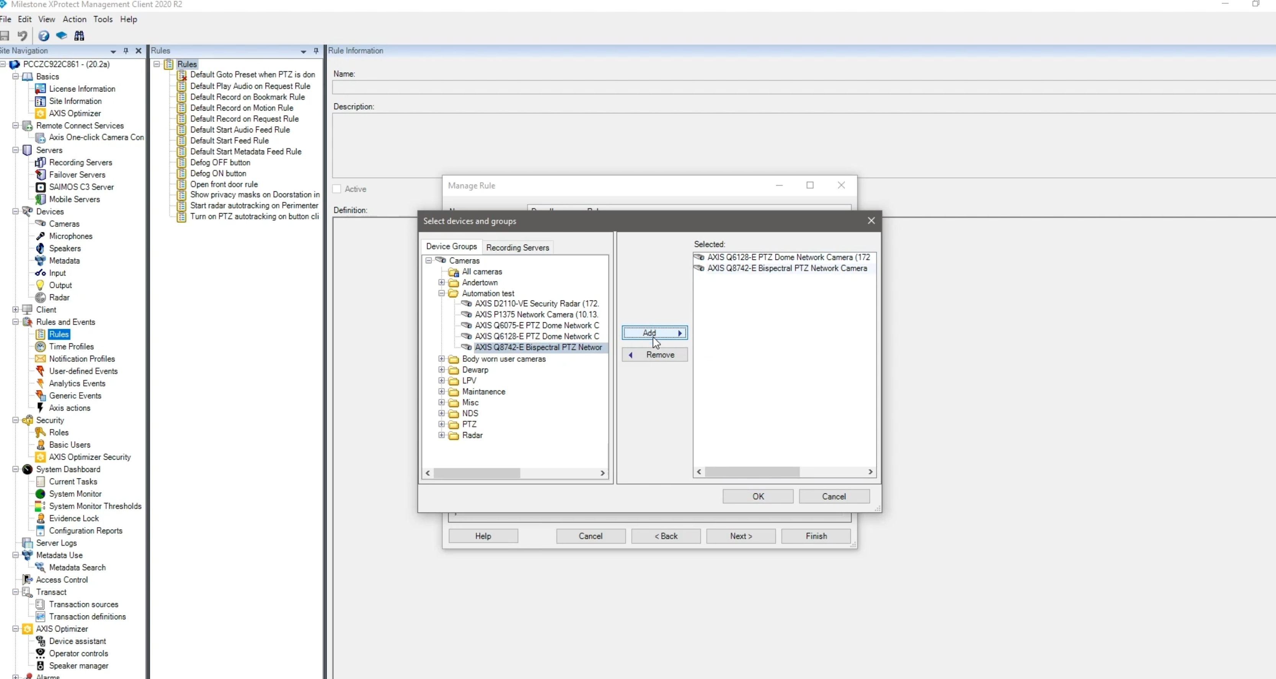
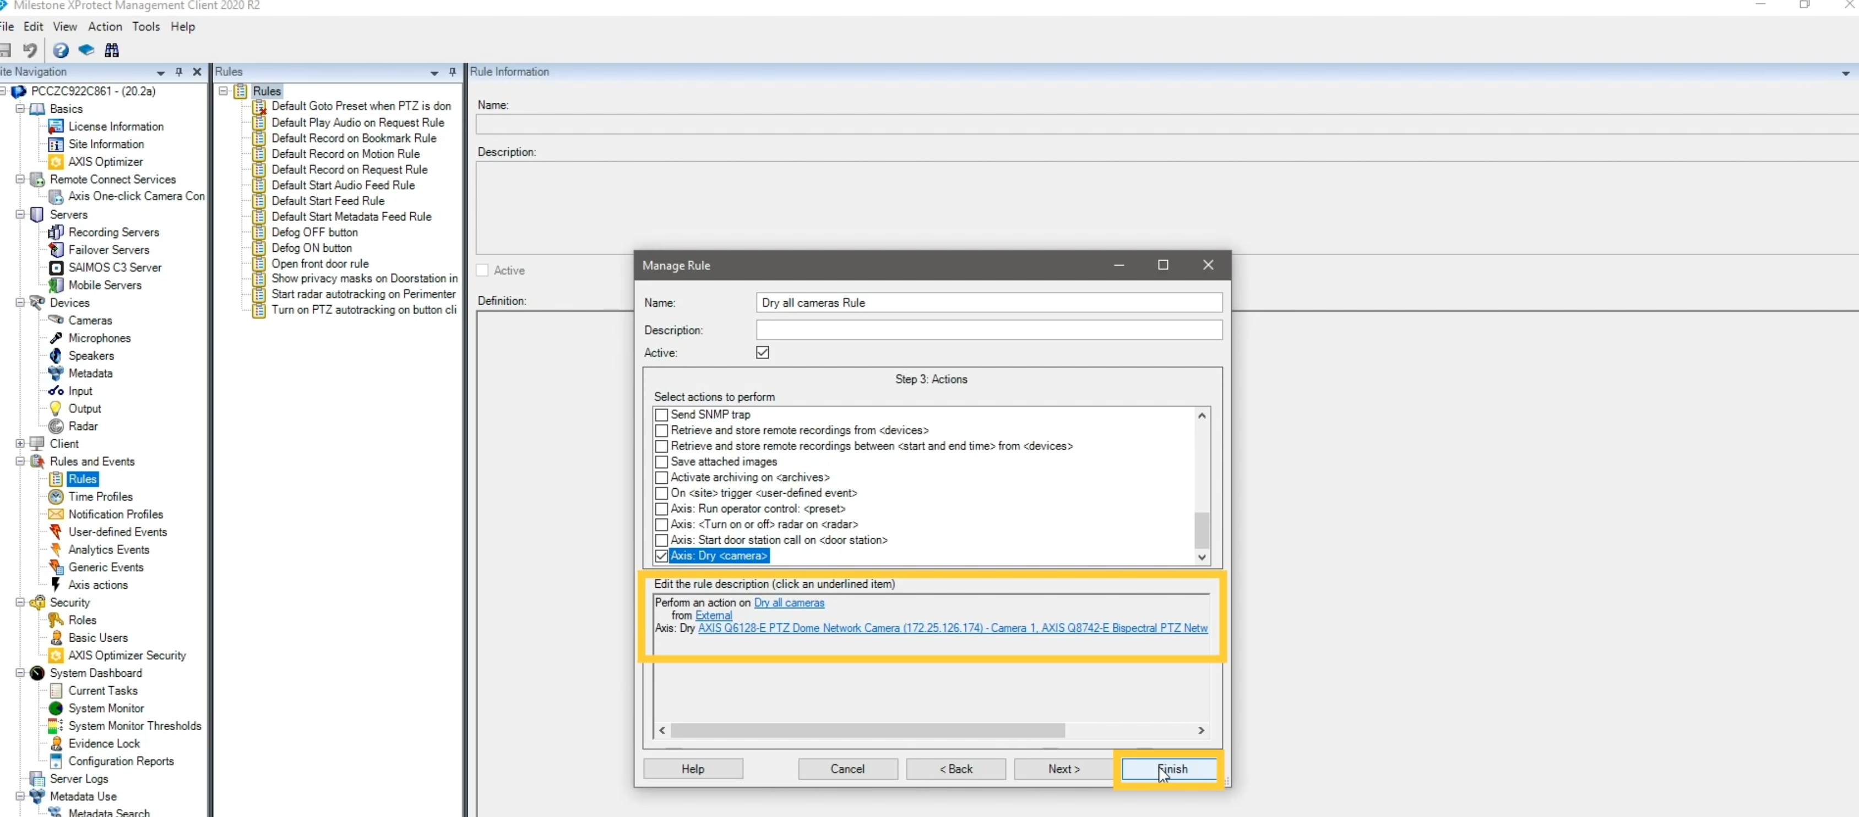
XProtect Rules Engine + AXIS Optimizer event server plugin
Admins set up custom rules to create automated actions as responses to real-time events
Uses XProtect rule engines to trigger automation on line crossing or crossline counting
Fully automated — triggers automated actions without operator interactio
1
2
3
4
Select rule for automated action
Select condition for automated action
Select action and devices
devices for automated action
Review and click finish
Ensures accurate, desired actions are are carried out in response to real-time events
Saves considerable time
Eliminates the risk of manual errors from occurring
Notes:
Set up custom rules to create full automated actions as responses to real-time crossline detection or counting events
Requirements
O Install your choice of:
- Milestone XProtect Express+
- Milestone XProtect Professional+
- Milestone XProtect Expert
- Milestone XProtect Corporate
- Milestone XProtect Essential+
O Install the latest version of AXIS Optimizer on the event server and Management Client
O Cameras that support either speed dry (dome) or wiper (positional) functionality

Slide 9
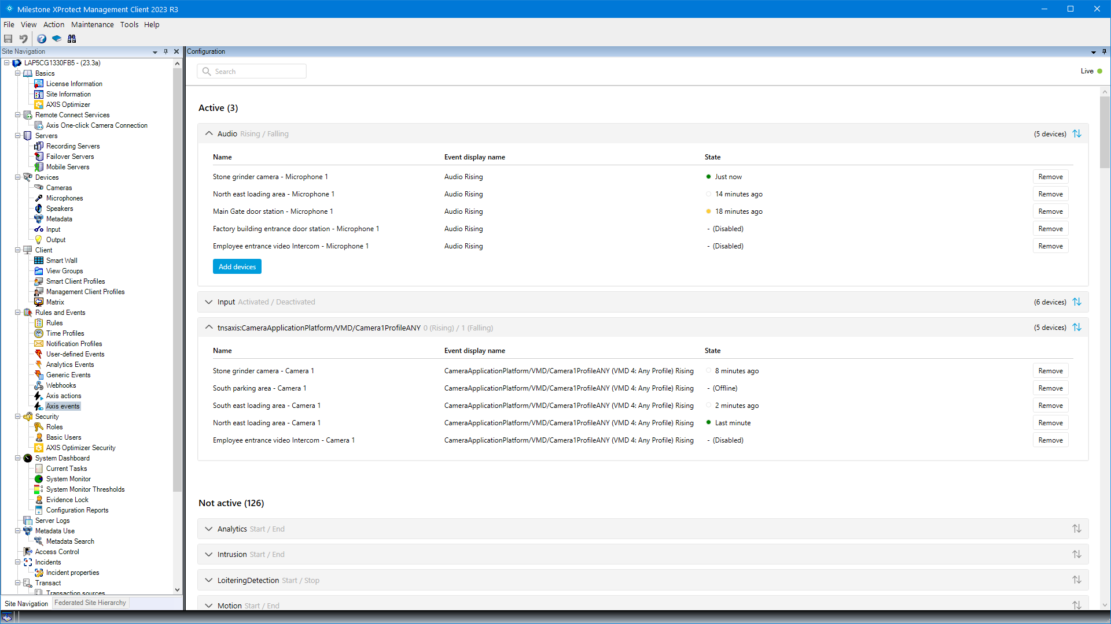
AXIS Optimizer events control panel
Dedicated control panel for managing Axis device events directly in XProtect Management Client
Admin roles can quickly:
  Search for events for all connected devices
  View status of events
    See which events are active/not active in the system
    See which devices an event is subscribed to
    See status of the event and last time it was triggered
  Add or remove events from devices
  Setup events for multiple devices in batch
Notes:
Background: managing events without Optimizer
Setting up events for Axis devices in XProtect is cumbersome and prone to human error. For instance, without AXIS Optimizer, users need to go to each
device to see associated events. This needs to be repeated for each device. Given the dramatic increase in the total number of events possible for Axis
devices, it’s difficult to gain an overview of and control events. Setting up, controlling, and managing automated device events in a VMS is crucial because automation is what transforms your surveillance system from a passive recording tool into an intelligent, proactive security system
How AXIS Optimizer solves this problem
AXIS Optimizer events control panel makes it easy for admin roles to manage events for all Axis devices in the system. It offers an overview
of all available events and helps admin roles get status of, manage, and troubleshoot Axis device events directly in XProtect. They can search for, monitor, and view details about all their events and add/remove events for
multiple devices with a few clicks. This streamlines event management for new and existing devices and offers improved status. awareness for Axis device events.
Note: by default, retention time is disabled (set to 0) in XProtect which means the “last triggered” column will always be blank unless the system admin changes the retention time settings in the management client.

Slide 10
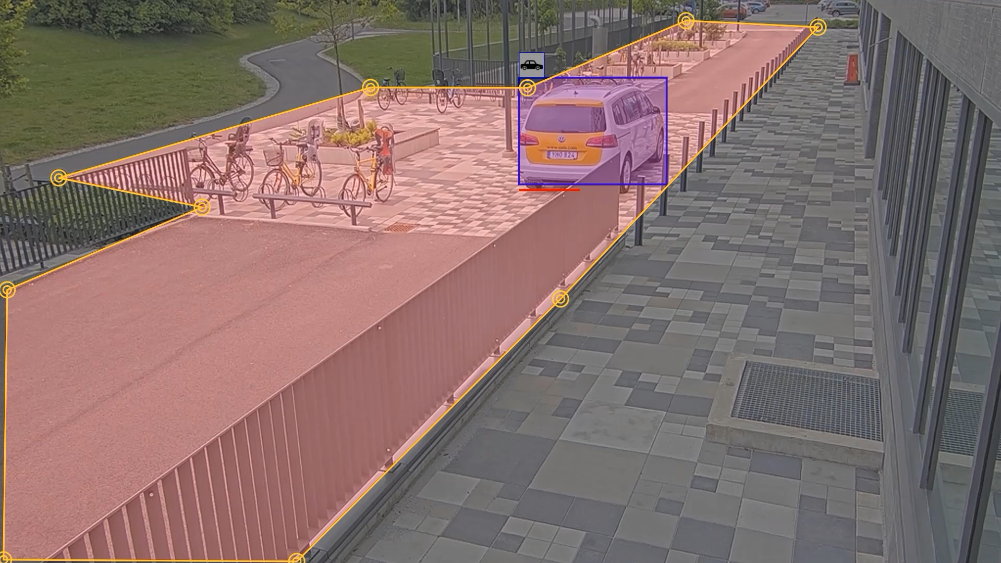
Managing events for Axis devices
Notes:
Film showing how AXIS Optimizer streamlines managing events for Axis devices in Milestone XProtect. This single control panel gives admin roles an overview of all available and subscribed device events. Users can quickly search all events for all connected devices, setup events for multiple devices in batch, easily remove or add devices from an event as well as see current state and last triggered date and time per device and event.
SCRIPT
Axis devices act as sensors to detect different types of events
Like when this camera detects an object has stayed in an area too long, that is the event that triggers an automated alarm or action
So events trigger actions
Which makes them important to be able to control.
Managing events for Axis devices in XProtect is time-consuming and error prone work.
Users need to find each device to see the associated events. Adding an event means scrolling through long and confusing lists.
This needs to be repeated for each device
Axis Optimizer gives an overview of all available and subscribed device events in a single control panel
Admin roles:
Quickly search all events for all connected devices
Setup events for multiple devices in batch
Easily remove or add devices from an event
See current state and last triggered date and time per device and event
Axis Optimizer events control panel streamlines setting up, testing & troubleshooting
and saves considerable time and effort

Slide 11
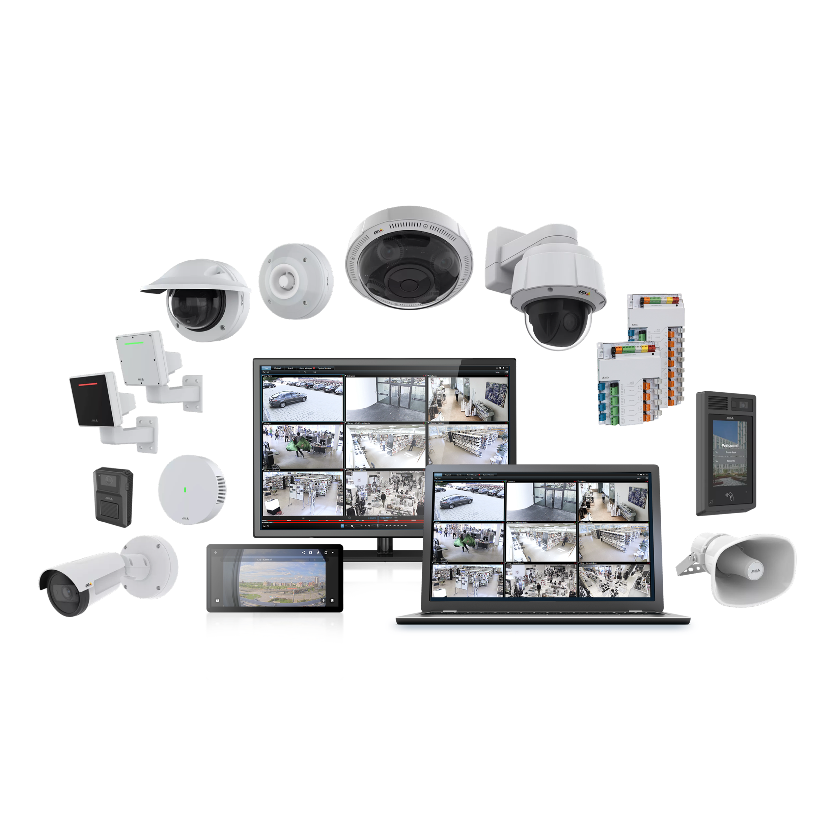

AXIS Optimizer for XProtect
Optimizes and unites Axis and Milestone systems
Notes:
About AXIS Optimizer for Milestone XProtect
It is a suite of integrations that optimizes Axis and Milestone systems by optimizing the performance of Axis devices in Milestone.
It optimizes performance of Axis devices — from PTZ, panoramic, fixed bullet and dome cameras to intercoms and speakers to AI cameras with Axis metadata to partner ACAPS and Axis analytics
It helps all system users save considerable time and eﬀort by:
Making all integrations available as one suite. Today, there are currently 20+ different integrations i.e. plugins/capabilities/features. No other device manufacturer offers this — instead, you need to manage each separately. This means: 1) Finding plugins; 2) setting up user roles for all devices; 3) setting up all enhanced capabilities and features for all devices; and 4) Maintaining all integration plugins/capabilities/features. See TCO slide for savings
Providing first line support from Axis for anything related to AXIS Optimizer for Milestone XProtect. Axis local teams are trained in the offering and backed up by the integrations team — both are ready to support you
Unlock unique Axis features directly in Milestone XProtect® no need to jump between multople software to use Axis devices in Milestone
Simplest way to get the most out of — and gain great experience using — Axis and Milestone systems
Ensures integrations are designed and validated by Axis to work optimally in Milestone XProtect.
Regularly updated and always available for free

Slide 12
Value AXIS Optimizer delivers
One suite, one-time installer: saves considerable time and effort
Ensures user gain maximum value from each Axis device
Unlock unique Axis features directly in Milestone
First line support from Axis
Designed and validated to work optimally in XProtect
Regularly updated with new capabilities
Always available as a free download on axis.com

Slide 13









Core use cases of AXIS Optimizer
Access device
settings
Access extended features
AI-powered automation
AI-powered data analysis
AI-powered forensic search
Apply security
controls
Manage access
control
Operator triggered
automation
Respond to
real-time events
System design
and maintenance

Slide 14





